Slide 1
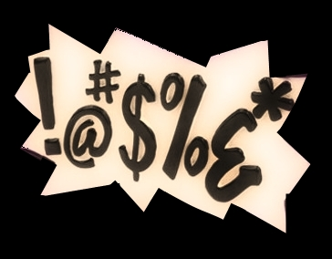
“Bad” Words
The SQL
Notes:
Welcome to Bad Words the SQL

Slide 2
PLOT (Problem Statement)
The purpose of this project is to determine if there is a correlation between the count of bad words and the rating of the movie
We're asking:
Do people like movies that have a sh*ton of f*cking bad words?
Are bad words being used more often now than in the past?
Notes:
Our team is asking the question: “Do people like movies that have bad words?”
To answer this question, we are looking for correlations between bad words in movies and user ratings. We are also interested in seeing trends in the date that a movie was released and the amount of bad words.

Slide 3

THE CREW
Gillian
Gadiano
Safwan
Muneer
Sarah
Perez
Zach Lighton

Slide 4
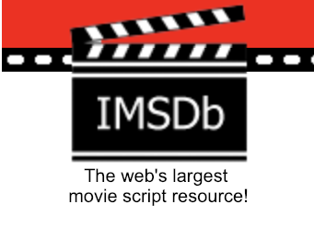
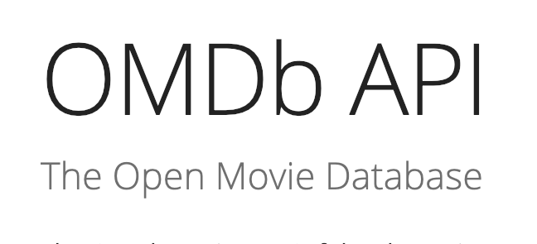
SPONSORS (Data sources)
Movie Database
(MySQL)
IMSDB
OMDB API
MPAA Ratings
Genre
IMDb Review Score
Cuss count
Total word Count
Movie Titles
Run time
Release Date
Notes:
We used two data sources for our analysis. The first was in Internet Movie Script Database (IMSDb). From this website, we scraped the movie scripts and counted the total number of words from a list of 11 as well as the total word count for the script. The second data source was the Open Movie Database (OMDb) API. We queried this API to get the Motion Picture Association of America (MPAA) rating, IMDB review, genre, and run time for the movie scripts for which we had data. We joined this data on Movie Title in PANDAS and then exported that information to a SQL database. Once in SQL, we further cleaned the data and then brought it back into PANDAS for analysis.

Slide 5
OUTTAKES (CHALLENGES)
urls needed for web scraping and API pulls required significant data transformation
Movie titles are formatted differently between the data sources
Addams Family, The vs The Addams family
Incomplete data – review scores missing
Scripts contain stage directions which may contain words not heard on screen but included in the word count
Notes:
Most of the challenges that we faced involved the Transformation piece of ETL.
- The for loops that were used to scrape data and complete the API pulls needed specific data formatting which required significant transformations.
The HTML on the website did not use classes and so was difficult to identify and pull the specific data that we needed. We ended up pulling a lot of data and then cleaning it up in the Dataframe.
We had originally wanted to pull more reviews from Rotten Tomatoes and Meta-Critic but this information was not available for many of the movies via the API so we only included the IMDB reviews.
The scripts that we found have stage direction which may contain words that were not heard by the audience but are included in the word counts. We were not able to remove the stage direction.

Slide 6
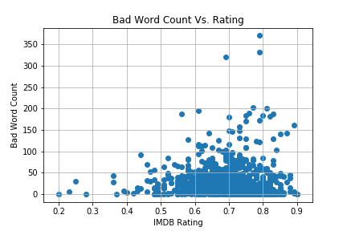
REEL CLIPS (data visualization)
Movies with the highest bad word count have decent ratings ranging from 6.9 to 7.9 out of 10.
Most of the movie ratings range between 5.5 to 8.6 with the total word count ranging 0 to 100 words.

Slide 7
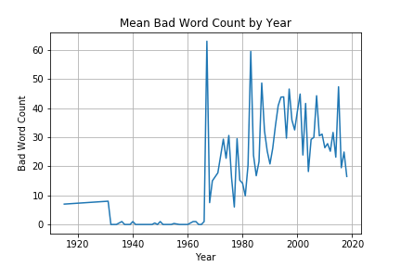
REEL CLIPS (data visualization)
The average bad words in movies ranged throughout the years
Movies in the 1970’s had the highest average of bad words per movie at a mean of ~62
In 1968 the MPAA creates a voluntary rating system

Slide 8
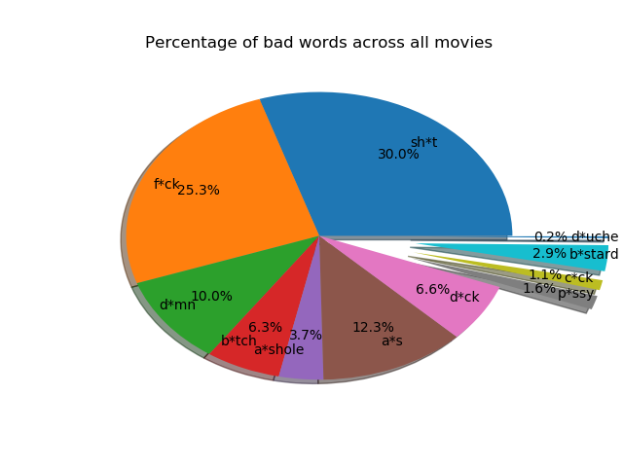
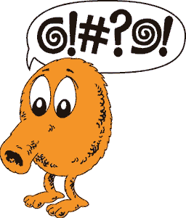
REEL CLIPS (data visualization)
S#!T , F@ck and @ss are the 3 most common bad words used in Movies
(There are more d!cks in Movies than there are p*ssy’s)

Slide 9
FINALE! (conclusion)
Films with higher ratings tend to have between 0-50 bad words
This implies that there is a threshold for the amount of bad words that audiences will tolerate
There has also been a trend to more bad words in films since 1968
The amount has leveled off since the 2000s
Notes:
Based on the available data and the limitations of this study. We did not find a strong correlation between bad words and movie ratings mainly because there are other factors that heavily impact a movie’s viewer rating which were not explored in this project - such as the story line, graphics, soundtrack, and the actors that portray characters in the movie.

Slide 10
Critique (Improvement ideas)
Scrape multiple review websites for more robust data
Compare the data by movie genre
Weight the words – not all words are equal
Add in more contextual cues

